Slide 1

Temperature & Humidity Measurement
Embedded Linux
By: John Padoginog, Steven Selementi, David Bisgrove

Slide 2
Project Description
Collects temperature & humidity.
Records at user-inputted intervals.
Stores data locally and remotely.
External website displays recorded data.
Requires user login.
Ability for frequency and timeframe adjustment.

Slide 3
Goals
Successful reading of temperature and humidity via DHT22 sensor.
Data table with recordings.
Administrative website:
Displays data.
Set frequency and time frame.
Acquire skills in:
Python programming.
Web programming/design.
Team skills.

Slide 4
Implementation
Our project implementation was broken into two major parts:
Operating Python code (Raspberry Pi):
Reads and stores temperature and humidity values.
Variable timeframe and frequency parameters.
Stores values into an SQL database.
Online Website (Wyvern):
Displays data tables remotely.
HTML Based.
Control of timeframe and frequency remotely.

Slide 5
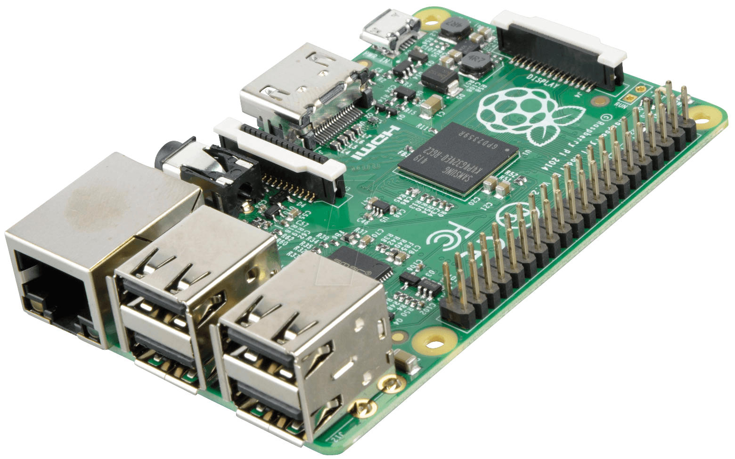
Physical Components
Raspberry Pi 3
Adafruit DHT22 Sensor
Breadboard
4.7K Resistor
Jumper wires
T-Cobbler

Slide 6

Software
Python
SQLite3
PHP
Wyvern
FileZilla

Slide 7
Process
Our system is set up to have communication between our local (Pi) and remote component (Webserver).
Raspberry Pi:
Powered with 5V power adapter
Connected to breadboard via T-Cobbler Plus
DHT22 Sensor:
1: VCC(3.3V)
2: Data – Connected to GPIO pin 04
3: N/A
4: GND
Python Code:
Reads and stores data into SQL database.
Set up to communicate to Wyvern Webserver.
Variable frequency and timeframe.

Slide 8
Process (cont.)
Remote webserver:
PHPMyAdmin
Apache2

Slide 9
Aspects
The Good:
Operating temperature and sensor reading
User input for variable frequency and timeframe
New knowledge of:
Python
Webserver Configuration
The Bad:
Invalid permissions for PHPMYADMIN

Slide 10
References
http://www.instructables.com/id/Turning-your-Raspberry-Pi-into-a-personal-web-serv/
http://www.instructables.com/id/Raspberry-PI-and-DHT22-temperature-and-humidity-lo

